Slide 1



Speech Denoising with Noise2Noise model Capstone Project Phase A #A-23-2-R-10
Students:
Omri Cohen
Eliav Shabat
Supervisors
Dr. Renata Avros
Prof. Zeev Volkovich
Notes:
אליאב
Hi, my name is Eliav and this is Omri and today we here present to you the capstone project we did on ‘Speech Denoising”

Slide 2
Table of contents
1
2
3
Introduction
Background
The model
4
5
6
Data preparation and Advantages
Expected Achievements
Evaluation Plan
and Potential challenges
Notes:
אליאב
We split the presentation into 6 main parts –
As we go through each part you will
get a better understanding of:
the research process and
the goals we would like to achieve through-out this project.

Slide 3

1
Introduction
Notes:
אליאב

Slide 4

The problem
Speaker recognition
Interference
Performed by a set of speaker characteristics comparison usually from audio recordings or from a military tactical communication system.
Accuracy and performance are based on the audio quality.
In Walkie-Talkie communication systems (e.g. ‘BNET’ in RAFAEL) there are a lot of interferences such as: chatters in the background, audio signal resampling, static interference, white noise etc.
Notes:
אליאב
Let first address the problem:
We are doing the project in collaboration with RAFAEL.
It is a part of a bigger project to perform speaker recognition while using a military communication systems.
In order to do that –
a set of speaker characteristics are being compared usually from audio recordings
or
straight from a military tactical communication system.
The accuracy and the performance are based on the audio quality.
This is where the problem comes in –
when using a Walkie-Talkie communication systems (such as BNET in RAFAEL) there are a lot of interference such as:
Chatters, audio resampling, static interference, white noises etc..

Slide 5
The solution
Denoise recordings - As a solution to the problem, the project proposes a model that aims to remove noise from recordings of a B-net walkie-talkie using a learning machine techniques. The model will provide clean recordings that will be used by Rafael for training a speaker recognition model.
The chosen approach for implementing the solution is N2N. A neural network-based method originally developed for image denoising and then denoising.
Notes:
עומרי
1. הפרויקט מציע פתרון באמצעות הסרת רעשים באמצעות למידת מכונה.
2. המודל אמור לתת מענה בזמן אמת לסינון הרעשים הנוספים לaudio signal שעובר בתקשורת הרדיו – הפלט יהיה מה שיכנס למודל זיהוי הדוברים.
3. בחרנו באלגורית N2N (היה לתמונה, היום לרעש)
4. בהמשך נרחיב על הארכיטקטורה Unet והיתרונות שלו.

Slide 6
2
Background
Notes:
עומרי

Slide 7


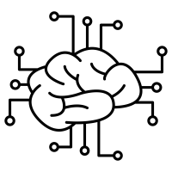
Denoising background
Training
Denoising
Machine learning
The network learns to identify the underlying patterns and relationships between the noisy input and the corresponding clean output.
Perform a series of mathematical operations (such as FFT or STFT) and transformations, using the learned patterns, to separate the speech signal from the noise
Using a network that learns the characteristics of the noise and thus removes it accurately.
Notes:
עומרי
אסביר באופן כללי על תהליך הסרת רעש באמצעות מכונה לומדת
שימוש ברשתות לומדות יכול לייעל את הסרת הרעש
2. למידת מאפייני הרעש
3. ביצוע פעולות מתמטיות והעברה ברשת להפרדה של הרעש מהדיבור

Slide 8
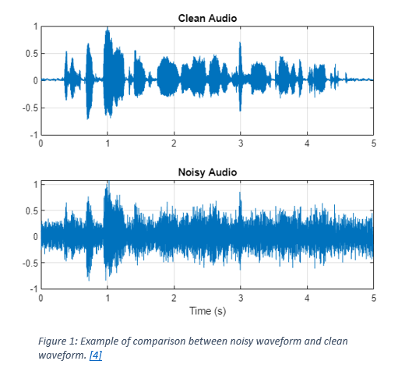
Waveform visualization – Clean vs. Noisy
Notes:
עומרי
השוואה בין 2 waverforms : נקי מול רועש.
הרעש מפריע לחילוץ המאפיינים העיקריים אותם אנו מחפשים.

Slide 9
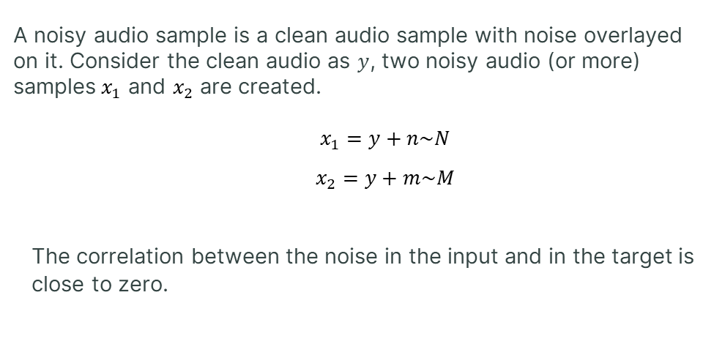
Noisy Audio Samples
A noisy audio sample is a clean audio sample with noise overlayed on it. Consider the clean audio as $y$, two noisy audio (or more) samples${ x}_{1}$ and $x_{2}$ are created.
$x_{1}=y+n\sim N$
$x_{2}=y+m\sim M$
The correlation between the noise in the input and in the target is close to zero.
Notes:
אליאב
What a noisy audio sample is?
The basic definition is simply a clean audio sample that a layer of noise is added on top of it.
דגימה רועשת היא דגימה שהוספנו עליה שכבת רעש.
מכל דגימה נקיה ניתן ליצור 2 או יותר דגימות מורעשות לצורך אימון.
לא להיכנס יותר מידי לפרטים – להגיד
Those two noises are normally distributed and uncorrelated to
y (which is the clean audio sample) – something which is very common

Slide 10
3
The Model
Notes:
אליאב

Slide 11
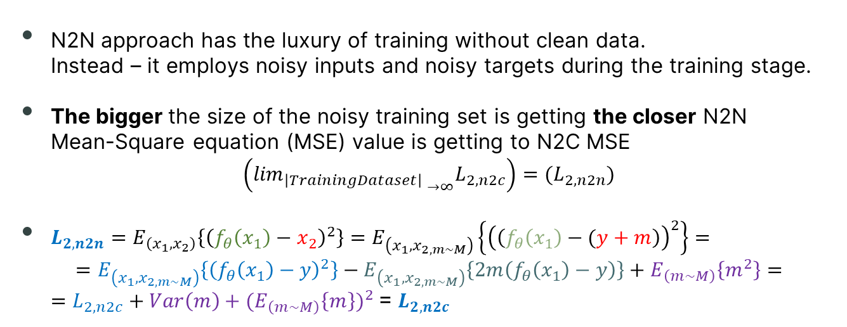
Noise2Noise (N2N) Approach
N2N approach has the luxury of training without clean data. Instead – it employs noisy inputs and noisy targets during the training stage.
The bigger the size of the noisy training set is getting the closer N2N Mean-Square equation (MSE) value is getting to N2C MSE
$$\left({{\lim_{\left|TrainingDataset\right| }}_{→∞}L}_{2, n2c}\right)={(L}_{2, n2n})$$
$L_{2, n2n}=E_{\left(x_{1},x_{2}\right)}\left\{{\left(f_{θ}\left(x_{1}\right)−x_{2}\right)}^{2}\right\}=E_{\left(x_{1},x_{2,m\sim M}\right)}\left\{{\left(\left(f_{θ}\left(x_{1}\right)−(y+m\right)\right)}^{2}\right\}=$ $=E_{\left(x_{1},x_{2,m\sim M}\right)}\left\{{\left(f_{θ}\left(x_{1}\right)−y\right)}^{2}\right\}−E_{\left(x_{1},x_{2,m\sim M}\right)}\left\{2m\left(f_{θ}\left(x_{1}\right)−y\right)\right\}+E_{\left(m\sim M\right)}\left\{m^{2}\right\}=$ $=L_{2, n2c}+Var\left(m\right)+{(E}_{\left(m\sim M\right)}{\left\{m\right\})}^{2}$ = $L_{2, n2c}$
Notes:
אליאב
Because of the little time we have at our disposal and due to the fact we are only 2 students
we chose this approach.
Noise to noise has the luxury of training a model without clean data.
Instead of spending a lot of time to search for clean audio samples we can use a relatively small amount of clean data to train our model.
The bigger the size of the noisy training set is getting,
the closer Noise-to-Noise outputs are getting to the standard approach of Noise-to-Clean results
בשורה ה1: X2 שווה ל y+m שזה הדגימה הנקייה + הרעש מעליה
בשורה ה2: ביצענו פתיחת סוגריים לפי נוסחת הכפל המקוצר
בשורה ה3: החלפנו את האיבר ה-1 בנוסחת ה Loss function של Noise2Clean האיבר ה-2 בשורה זו שווה ל0 האיבר ה-3 מורחב לביטוי בסגול (התוחלת של m^2 שווה ל Var(m)+E(m^2) לאחר ההרחבה של האיבר השלישי – ניתן להגיד שהביטוי [E(m)]^2 שווה ל-0.
בנוסף Var(m) = Var(population/sampling size) כלומר – ככל שגודל ה Dataset עולה כך ה
שונות שואפת לאפס ואנו מקבלים ש- Loss(N2N) שואף ל Loss(N2C)

Slide 12
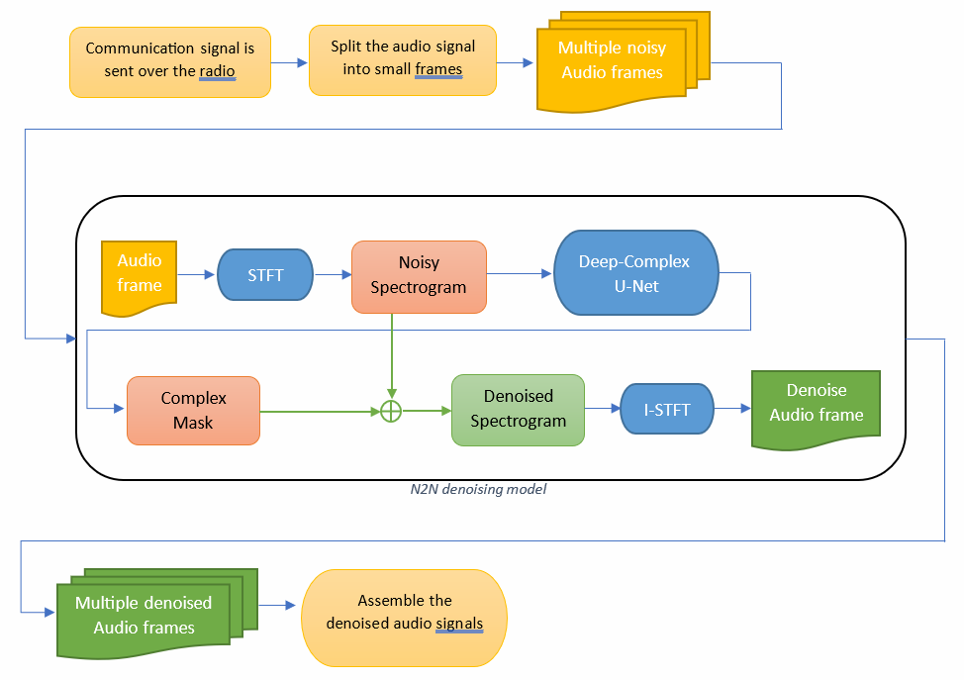
Flow diagram
Notes:
עומרי
תהליך של הסרת רעש לאחר אימון המודל
הכנה של הקלט לאלגוריתם
מעבר בSTFT
מעבר ברשת
מעבר בSTFT הפוך
סידור מחדש של המידע לקובץ נקי

Slide 13
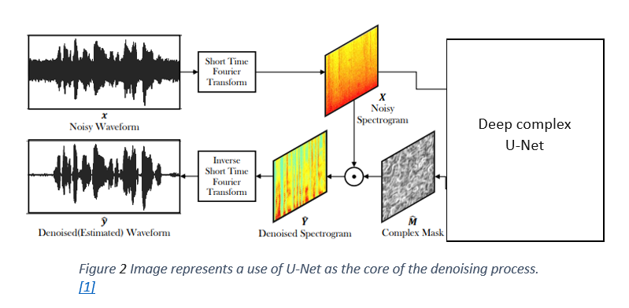
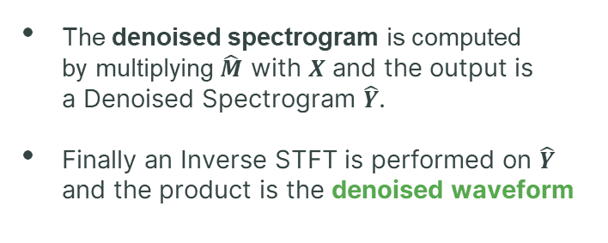
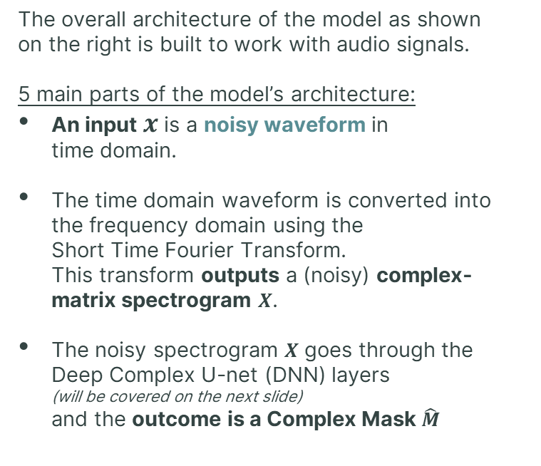
Model architecture
The overall architecture of the model as shown on the right is built to work with audio signals.
5 main parts of the model’s architecture:
An input $x$ is a noisy waveform in time domain.
The time domain waveform is converted into the frequency domain using the Short Time Fourier Transform. This transform outputs a (noisy) complex- matrix spectrogram $X$.
The noisy spectrogram $X$ goes through the Deep Complex U-net (DNN) layers (will be covered on the next slide) and the outcome is a Complex Mask $\hat{M}$
The denoised spectrogram is computed by multiplying $\hat{M}$ with $X$ and the output is a Denoised Spectrogram $\hat{Y}$.
Finally an Inverse STFT is performed on $\hat{Y}$ and the product is the denoised waveform
Notes:
אליאב
This is an overall brief look at the model architecture, we will dive in to the structure of the Deep neural network in the next slide
Getting a noisy waveform (time domain)
Performing an STFT to translate it into a spectrogram in frequency domain
Transfer the noisy spectrogram through the DC U-Net (which will be explained in the next slide)
The output of the DC U-Net is a mask which will be multiplied with the noisy spectrogram The result is a Denoised-spectrogram
Performing an Inverse STFT to get the Denoised Waveform

Slide 14
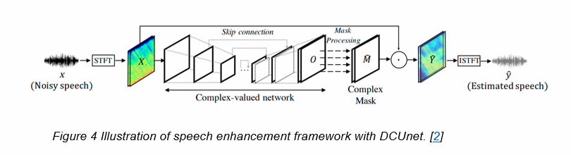
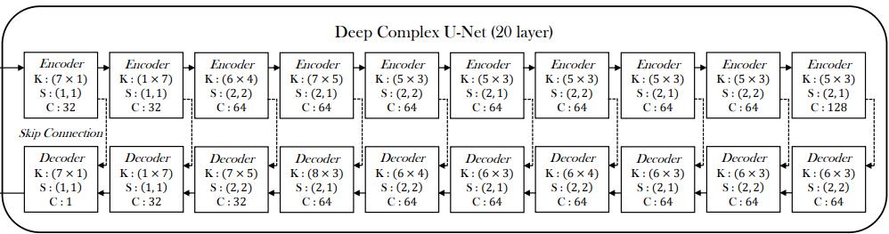
Network architecture – DC U-Net
DC U-net processes both phase and magnitude spectrograms, resulting in enhanced audio reconstruction with better precision and better results in denoising.
The encoding and decoding stages of the network consist of a complex convolution with specified kernel sizes, stride sizes, and output channels as described by the picture bellow.
The skip connections between the encoder and decoder facilitate the combination of low-level features from the encoder with high-level features from the decoder.
Activation Function is applied to both real and imaginary parts of the neuron -
Notes:
אליאב
DCU-Net serves as the core basis for our project.
Its ability to capture and process complex patterns in the audio data translate to a better noise removal
This can be achieve because of 3 main things:
The Encoder and the Decoder which consist of a complex convolution – with specified kernel, stride sizes and output channels as described.
The skip-connections – which is commonly used structure that allows to combine low and high level features of the audio samples while removing the noise.
The activation function – which applied both on the real & the imaginary parts of the neuron.

Slide 15
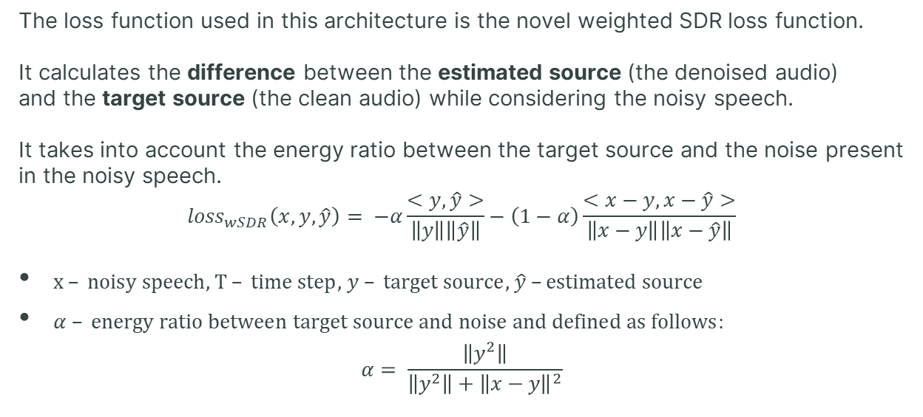
Network architecture – Loss function
The loss function used in this architecture is the novel weighted SDR loss function.
It calculates the difference between the estimated source (the denoised audio) and the target source (the clean audio) while considering the noisy speech. It takes into account the energy ratio between the target source and the noise present in the noisy speech.
$${loss}_{wSDR}\left(x,y,\hat{y}\right)= −α\frac{<y,\hat{y}>}{\left\|y\right\|\left\|\hat{y}\right\|}−\left(1−α\right)\frac{<x−y,x−\hat{y}>}{\left\|x−y\right\|\left\|x−\hat{y}\right\|}$$
$x – noisy speech$, $T – time step$, $y – target source$, $\hat{y} –estimated source$
$α – energy ratio between target source and noise and defined as follows:$ $α= \frac{\left\|y^{2}\right\|}{\left\|y^{2}\right\|+{\left\|x−y\right\|}^{2}}$
Notes:
עומרי 1. פונקציית הפסד SDR
2. מחשבת מרחק בין הערכה של הסרת רעש למקור.

Slide 16
4
Data Preparation and
Advantages
Notes:
עומרי

Slide 17
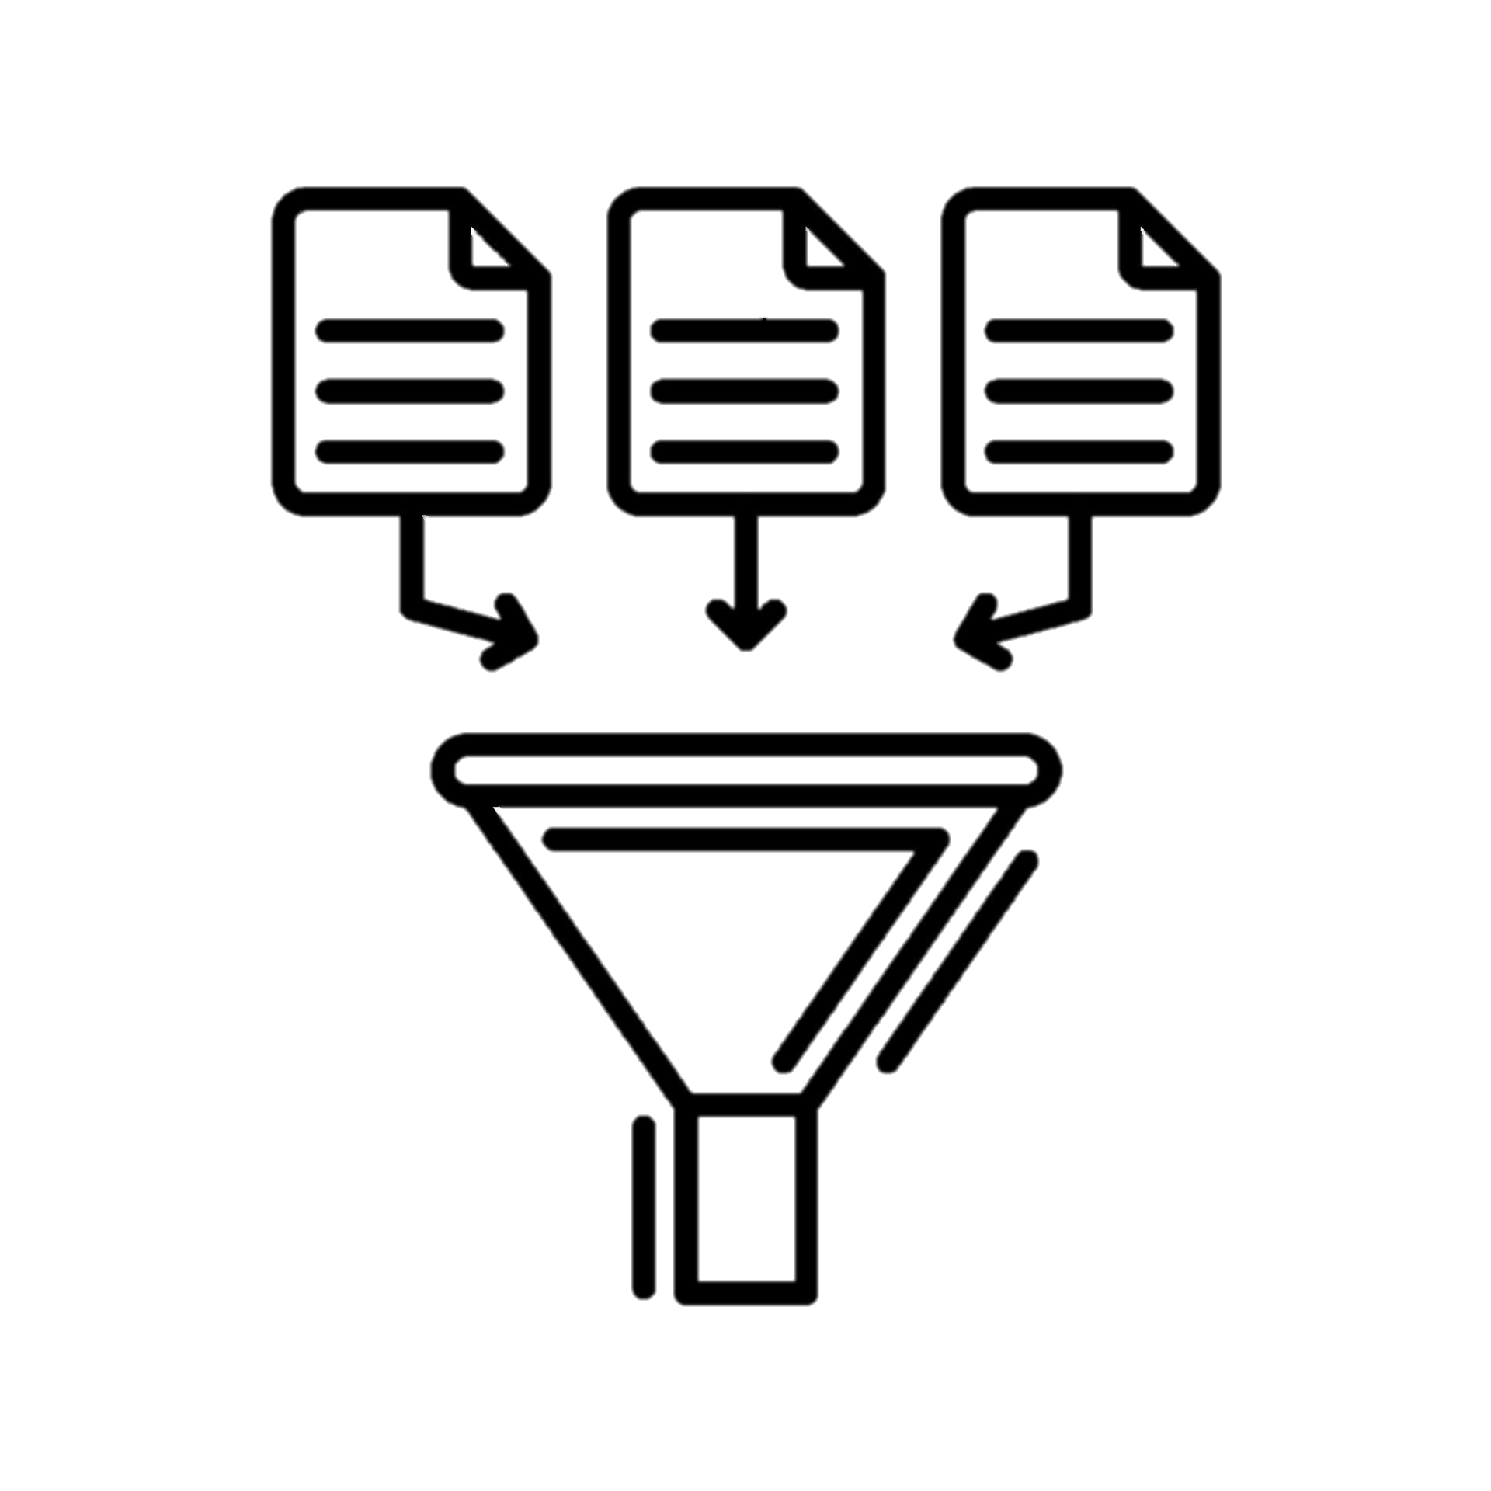


Datasets and Data Generation for N2N training and evaluation
Collection of existing audio recordings of a BNET radio from RAFAEL, recording of additional samples. Using existing data sets from existing packages and transferring them through a BNET radio.
Manipulating the recordings using Pydub library
Complying the manipulated recordings with predefined metrics such as Signal-to-Noise Radio (SNR) and PESQ (speech quality metric).
Notes:
עומרי
נבצע איסוף של הקלטות מרפאל וניצור הקלטות בעצמנו
נעביר הקלטות נקיות דרך BNET
נבצע מניפולציות על ההקלטות – כך שיענו על התנאים שהזכרנו קודם לכן (like - Normally Distribution) to meet the requirements of the algorithm input
נבדוק שהן עומדות במטריקות שהגדרנו

Slide 18



N2N Advantages (against N2C)
Cost Efficiency
Requires relatively small amount of clean data
Potential for Robustness
N2N is trained on noisy data so it is more robust to noise in real-world usage.
By using noisy data, N2N can potentially reduce the cost and effort involved in preparing the training dataset.
In many real-world scenarios, obtaining clean data can be challenging.
N2N is that it requires relatively small amount of clean data (noise-free).
Notes:
עומרי
איסוף של הרבה הקלטות נקיות יכול להיות מאתגר ולא אפשרי
N2N מאפשר איסוף של פחות הקלטות נקיות
יכול להיות יותר עמיד ויציב במקרים של רעשים מהעולם האמיתי
מחיר של איסוף דגימות נקיות גבוה
הכנת הדאטה לאימון יכולה לעלות פחות

Slide 19
5
Expected Achievements
Notes:
אליאב

Slide 20
Expected Achievements
Ability to achieve good training results even with limited amount of clean data.
Enhance speaker's sound quality through eliminating noise from the signal.
Actual Products:
Comprehensive summary & Theoretical insights.
Algorithm implementation.
Notes:
אליאב
The achievement we expect to get are:
The ability to get good training results although we use a relatively small amount of clean data
Get a good performance in noise removal and by that – improve the accuracy of the Speaker recognition model (which is being developed by RAFAEL)
The products of this project are:
Comprehensive summery and theoretical insights we gathered through the project development
Algorithm implementation which includes the code and everything that we need to run it flawlessly.

Slide 21



Gui
The interface will be written using Python and "tkinter" library.
N2N denoiser
N2N denoiser
N2N denoiser
Welcome to N2N denoiser.
Please choose audio file or audio folder.
File uploaded: <File name>
File denoised successfully
Play
Play original
Upload file
Denoise
Play Denoise
Upload folder
Back
Back
Back
Notes:
עומרי
הגוי יאפשר הסרת רעש האמצעות הרשת בצורה פשוט למשתמש
הסבר על 3 התמונות
כדי לשפר את חווית המשתמש יש גם GUI שיוכל לאפשר ממשק נוח להסרת רעשים מקבצי אודיו. (בלי קשר למודל שישולב במערת של רפאל)

Slide 22
6
Evaluation Plan and
Potential challenges
Notes:
אליאב

Slide 23
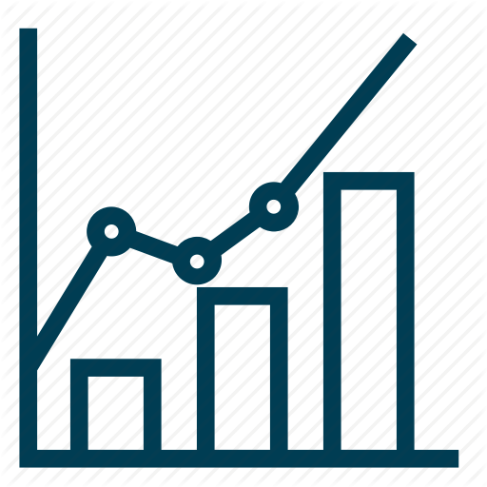

Evaluation/Verification Plan
Iterative Product Evaluation and Verification Plan for N2N:
Define general metrics to measure success at each iteration:
Noise removal accuracy – measure accuracy by comparing denoised and original audio signals using Mean Squared Error or Signal-to-Noise Ratio.
Speech recognition accuracy improvement over time
Iteration 1
• Training and Validation: Train the initial Noise2Noise deep learning model using a dataset of noisy audio inputs and corresponding noisy targets.
Validate the model's performance on a separate validation dataset.
• Evaluation:
Measure the accuracy of noise removal by comparing the denoised audio with the original noisy audio using metrics (e.g. MSE or SNR).
Evaluate the speech recognition accuracy on the denoised audio samples using a pre-trained speech recognition model (using PESQ).
• Verification:
Visually assess the quality and level of noise removal by comparing the denoised audio with the original noisy audio.
Notes:
אליאב

Slide 24


Evaluation/Verification Plan
Iterative Product Evaluation and Verification Plan for N2N:
Iteration 2 and Beyond • Training and Validation: Further train the Noise2Noise model using additional (new) noisy audio inputs and corresponding noisy targets. Perform cross-validation to evaluate the model's generalization ability.
• Evaluation: Compare with the previous iteration and continue measure by the proposed metrics
• Verification: Continuously visually assess the quality of denoised audio. Verify the impact on speech recognition accuracy and compare with the previous iteration.
Success Criteria and Iteration Termination:
Success criteria: Speech recognition accuracy > 90%, SNR improvement > 10dB.
Terminate the iterative development process when the success criteria for all metrics are met.
If the success criteria are not met, continue iterating by fine-tuning the model, adjusting hyperparameters, or augmenting the training data.
Notes:
אליאב
לוודא מאיטרציה לאיטרציה שלא מתרחש over-fitting
יש לקחת בחשבון שהמספרים המוזכרים הם ראשוניים (intial) ועלולים להשתנות ככל שנתקדם במימוש המודל.
ממשיכים כל עוד התנאים להצלחה לא התקיימו – כלומר עד שמגיעים לתוצאה מספקת

Slide 25


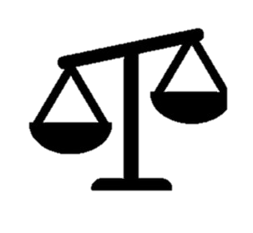
Potential challenges
The data collection should be carried out in coordination with RAFAEL and depends on their resources and capabilities. In addition, there are security aspects that we will have to consider during the collection.
Training the algorithm may require a work environment with powerful enough hardware. Adjust the dataset to fit the training phase.
The model was originally trained on white noises and in communication through BNET the noise will be different.
Notes:
עומרי
איסוף מידע מרפאל צריך להיות בתיאום
היבטים אבטחתיים
אימון המודל מצריך סיבת עבודה חזקה
We don’t know how well the model performance will be when using the B-Net recordings

Slide 26
Thanks for listening

